Slide 1
First LEGO League
Introduction to Hardware and Software

Slide 2

First LEGO League
The FIRST LEGO League Challenge (formerly known as FIRST LEGO League) is an international competition organized by FIRST for elementary and middle school students
Each year in August FIRST LEGO League Challenge teams are introduced to a scientific and real-world challenge for teams to focus and research on.
The robotics part of the competition involves designing and programming LEGO Mindstorms robots to complete tasks.
The students work out a solution to a problem related to the theme and then meet for regional, national and international tournaments to compete, share their knowledge, compare ideas, and display their robots.
The FIRST LEGO League Challenge is a partnership between FIRST and the LEGO Group.

Slide 3
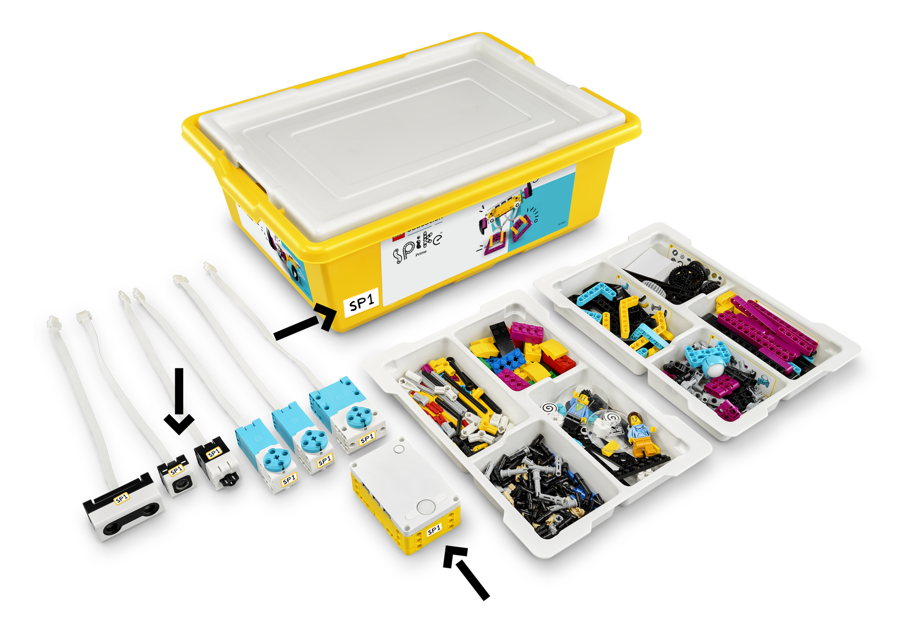
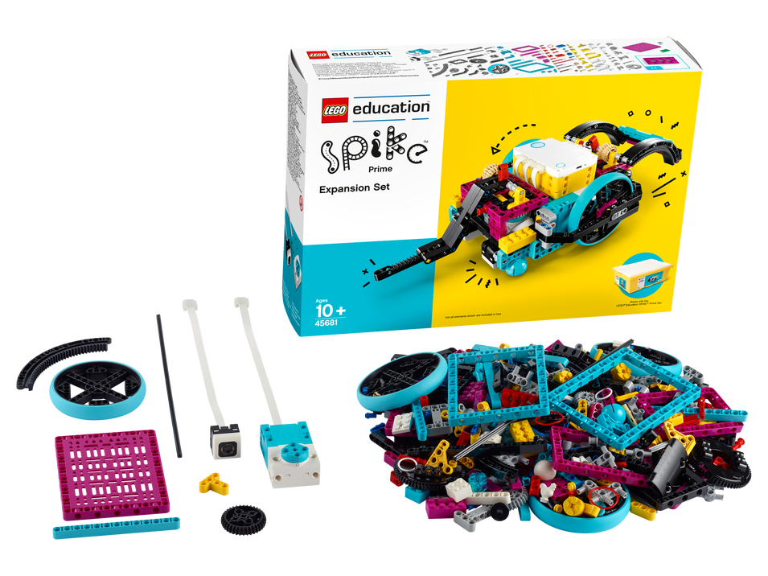
SPIKE Prime set
LEGO Education SPIKE Prime Set
LEGO Education SPIKE Prime Expansion Set

Slide 4
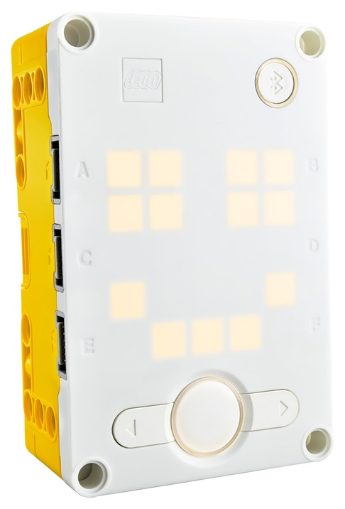
LEGO Technic Large Hub

Slide 5
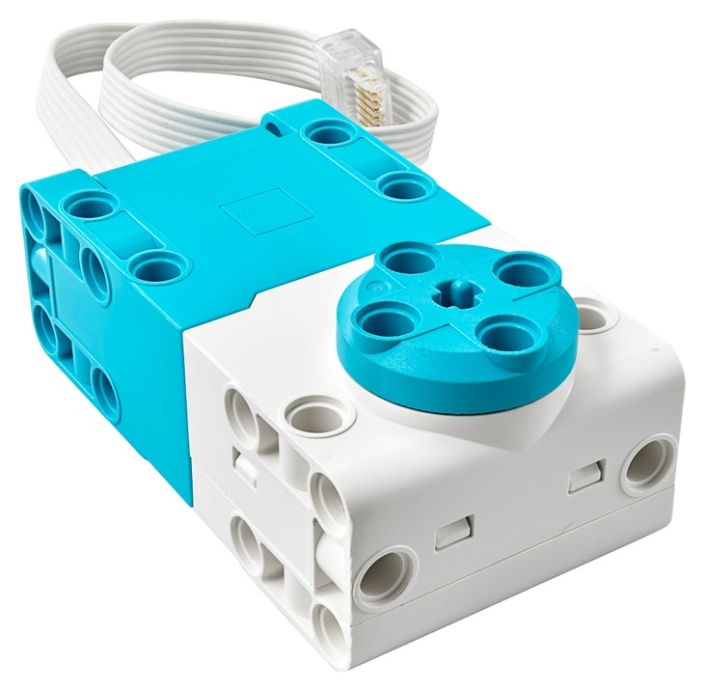
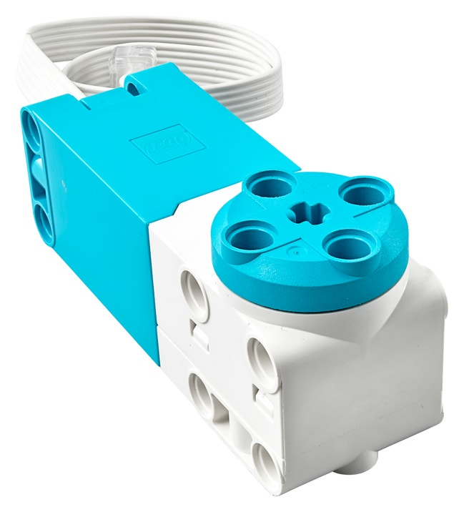
Angular Motors

Slide 6
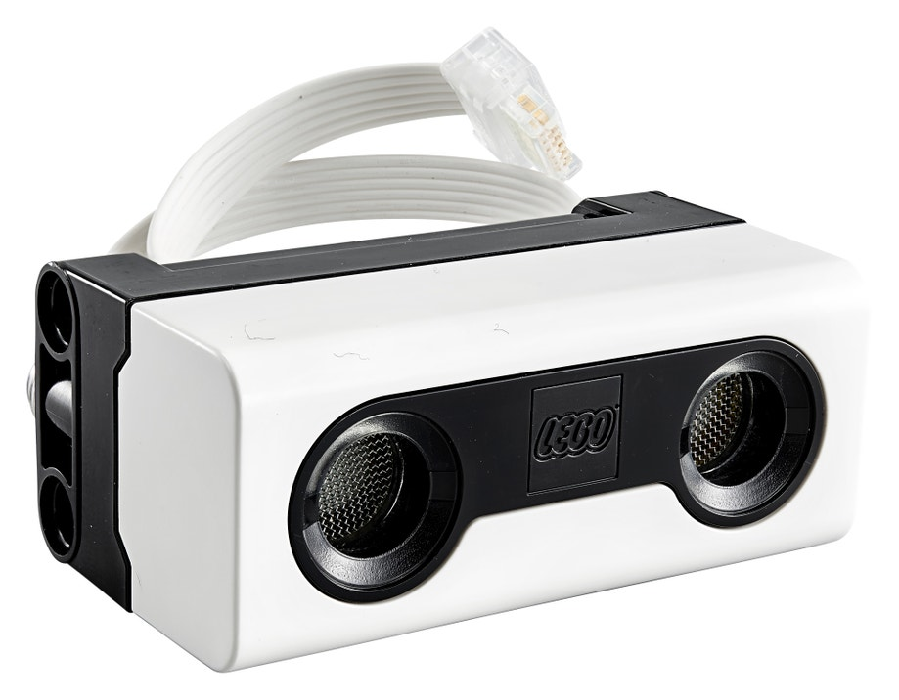
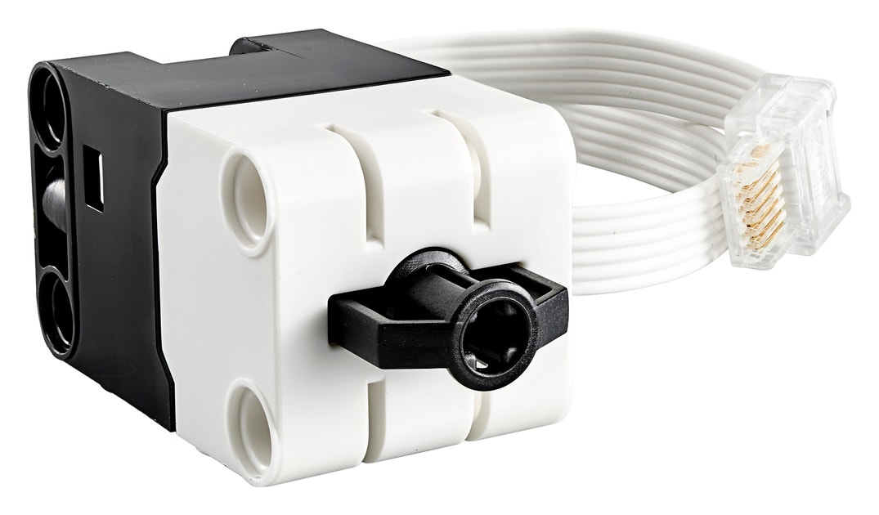
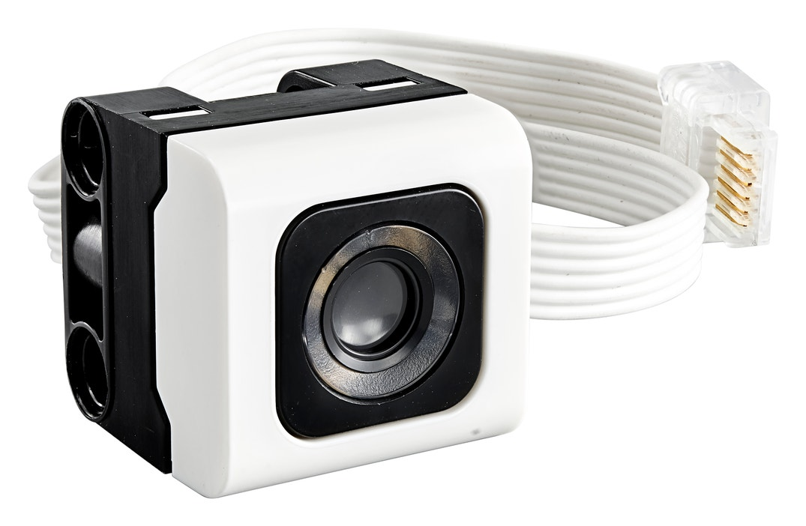
Sensors
Distance Sensor
Force Sensor
Color Sensor

Slide 7
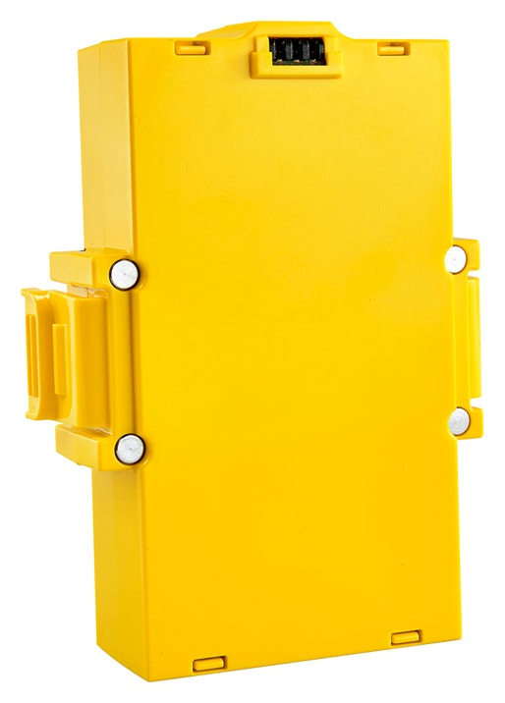
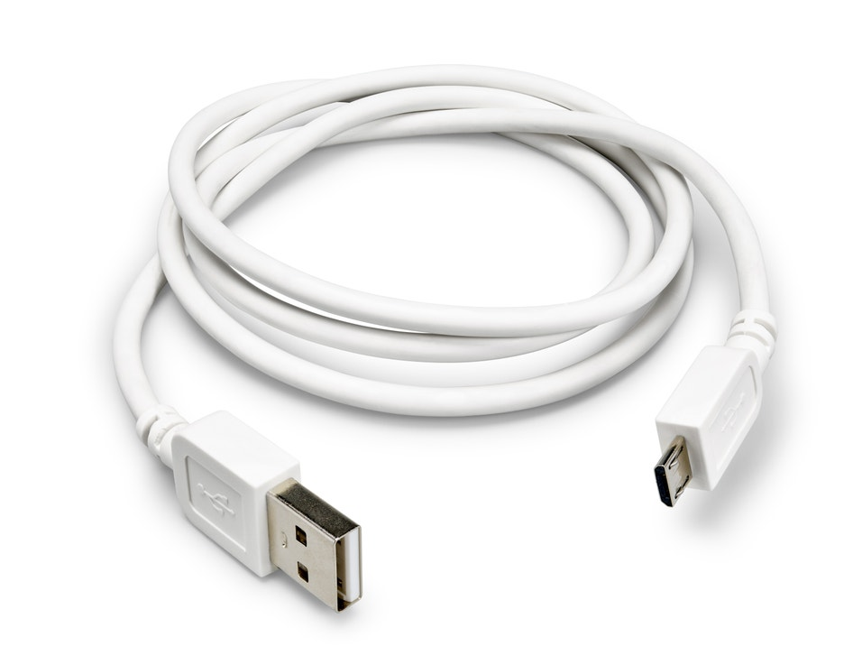
Battery

Slide 8
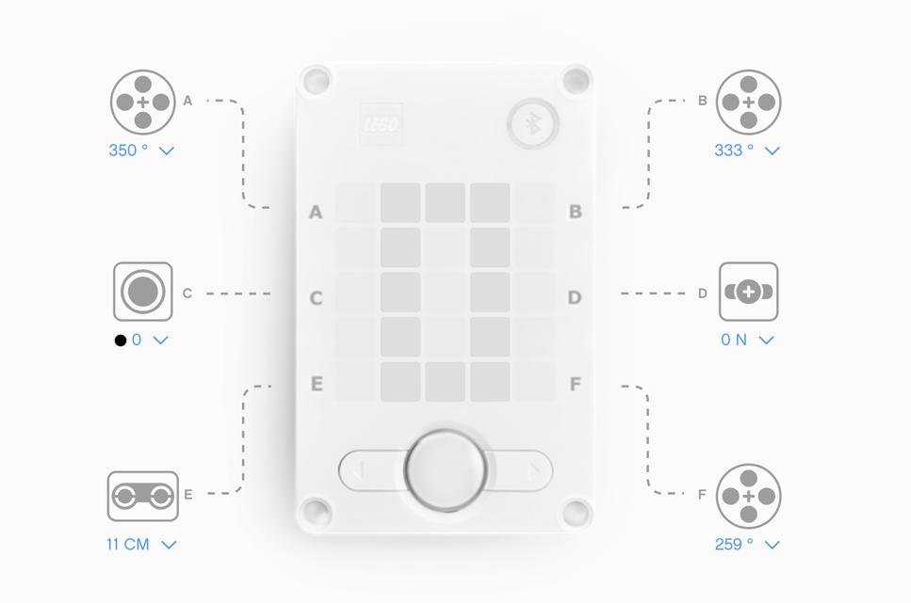
Connection Layout

Slide 9
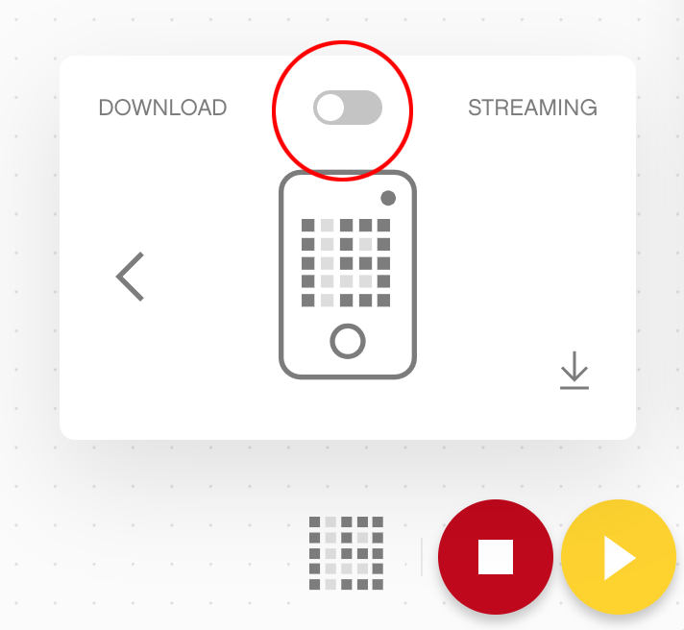
Download vs. Streaming Mode
Download mode is the default mode that allows you to save your programs to the Hub, disconnect it from your device and execute the program by selecting the program saved on the Hub.
Streaming mode allows you to play programs in real time, it enables you to play the program and change the parameters of the program as it’s playing.

Slide 10
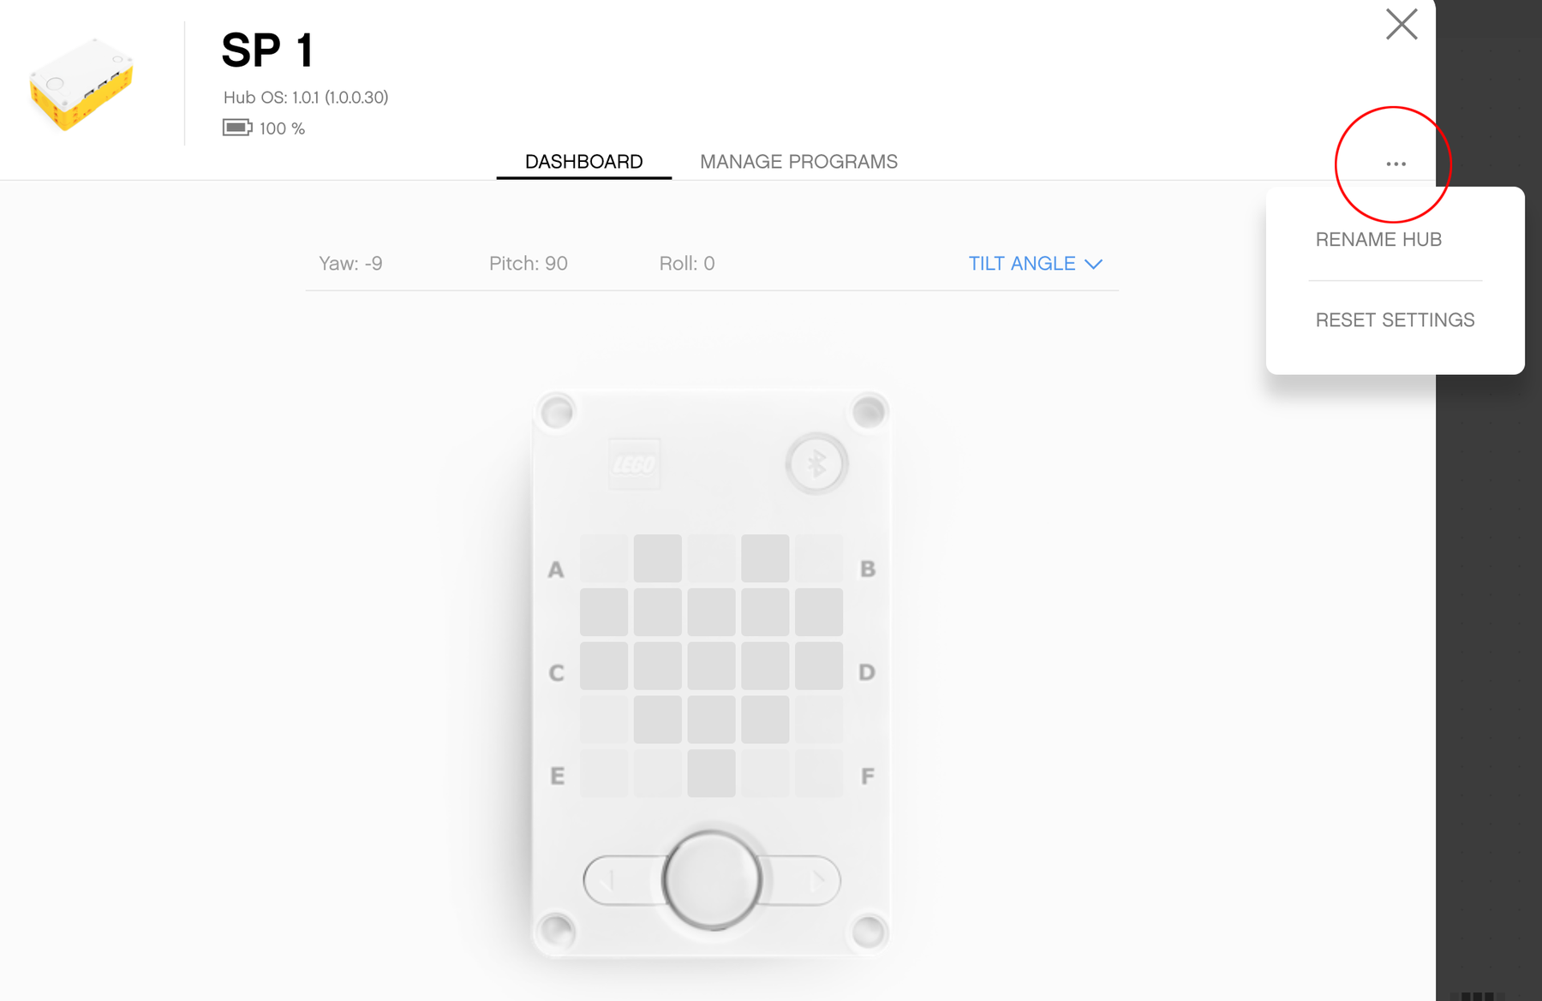
Personalize your Hub

Slide 11
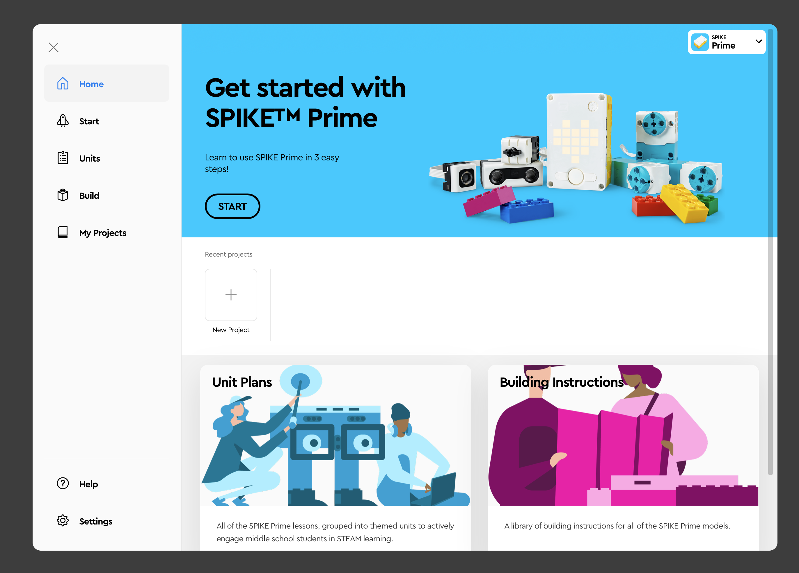
The Spike App

